Slide 1

SEAM – Q&A and Intelligence Briefing
Notes:
CSE - Gangs,
Four key messages

Slide 2
Sexual health & behaviour | Concerns of sexually transmitted infections, pregnancy and termination; inappropriate sexualised behaviour
Absent | From school or running away – episodes of truancy or periods of being missing from home or care
Familial abuse | Problems at home – familial sexual abuse, physical abuse, emotional abuse, neglect, risk of forced marriage or honour-based violence; domestic violence; substance misuse; parental mental health concerns; parental criminality; experience of homelessness; looked fater child
Emotional and physical condition | Thoughts of or attempted, suicide or self-harming; low self-esteem or self-confidence; problems relating to sexual orientation; learning difficulties; poor mental health; unexplained injuries or changes in physical appearance identify
Gangs, | Older age groups and involvement in crime – involvement in crime; direct involvement with gang members or living in a gang-afflicted community; involvement with older individuals or lacking friends from the same age group; contact with other individuals who are sexually exploited
Use of technology, sexual bullying | Evidence of ‘sexting’, sexualised communication on-line or problematic use of the internet and social networking sites
Alcohol & drug misuse | Concerns regarding alcohol and or substance use
Receipt of unexplained gifts or money | Unexplained finances, including phone credit, clothes and money
Distrust of authority figures | Resistance to communicating with parents, carers, teachers, social services, health, police and others

Slide 3
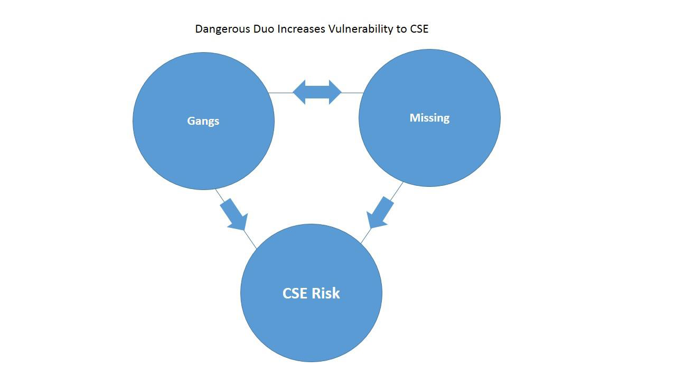
Vulnerable Adolescents
At Risk

Slide 4
Age and Ethnicity
The first SEAM was completed on 19th September 2017 – there have been 96 completed up to 22nd March 2018. These refer to 81 individual young people. 9 have had 2 SEAMs and 4 have had 3.
The most common age is 16 with 32% being this age.
30 of the young people (31%) are White British

Slide 5
Responsible Team

Slide 6
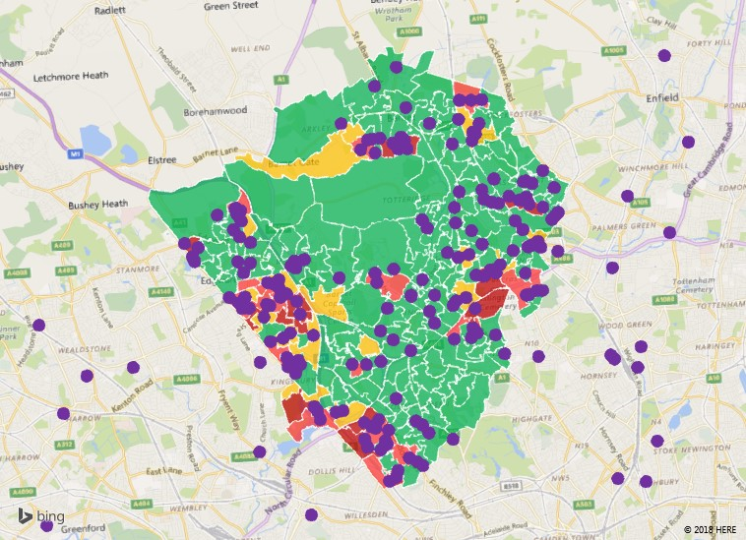

Slide 7
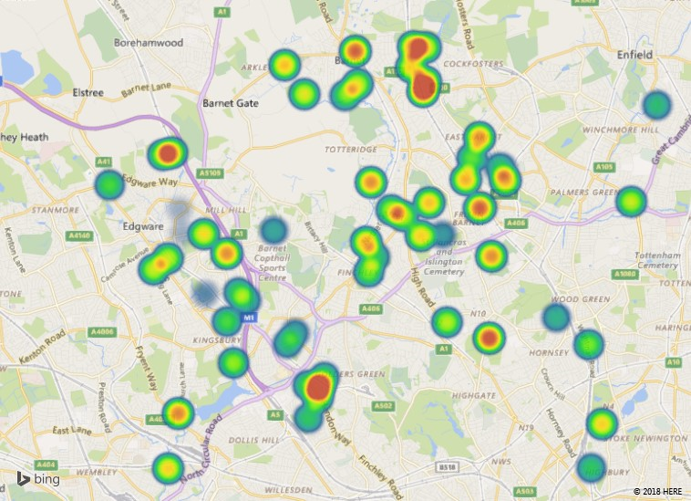

Slide 8
Scores
The high scores for familial concerns show that many of the young people have suffered abuse and often experience low warmth, attachment or trust with their parent / carer. Often the parent / carer does not implement age appropriate boundaries.
With the high scores for recognition of abusive and exploitative behaviour, it seems the young people assessed do not identify and recognise abuse and exploitation effectively.
Gangs and association with criminals / adults who pose a risk scores highly suggesting young people are being groomed and coerced into inappropriate behaviour.
Positively, the young people assessed generally scored low for sexual health. It appears there is awareness of where to get support and advice from.
Also, most of the young people use technology and social media responsibly and are aware of the risks and dangers on-line.

Slide 9
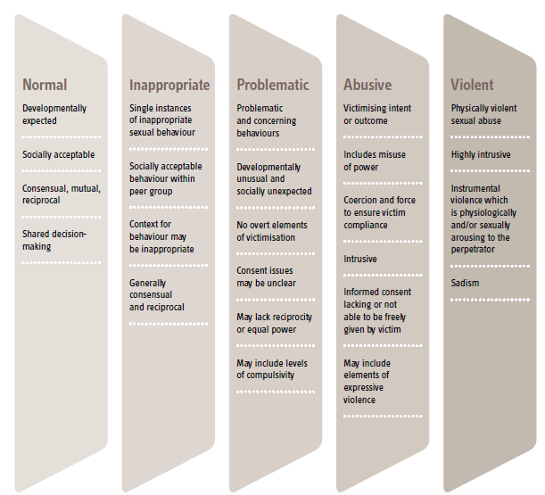

Slide 10
Number of Agencies | 0 | 1+ | 2+ | 3+ | 4+ | 5+
Number of SEAMs | 17 | 54 | 38 | 22 | 2 | 1
Agency | Sep-17 | Oct-17 | Nov-17 | Dec-17 | Jan-18
Education | 29% | 38% | 56% | 38% | 78%
Health | 14% | 5% | 19% | 13% | 6%
Police | 43% | 48% | 56% | 75% | 28%
SEAM Total in month | 7 | 21 | 16 | 8 | 18
Number of partners attending | High | Medium | Low | No Score | Total
0 | 5 | 6 | 3 | 3 | 17
1+ | 4 | 3 | 7 | 2 | 16
2+ | 6 | 7 | 3 |  | 16
3+ | 6 | 11 | 3 |  | 20
4+ | 1 |  |  |  | 1
5 | 1 |  |  |  | 1
Total | 23 | 27 | 16 | 5 | 71

